Slide 1
Deep Learning Architecture
7th Sem BE : Professional Elective Course :22CS721
3rd Sem MSc. CS(AIML): 23MSAI310
Course Tutors:
Dr.Srinath.S, Rakshitha R, Divya HN
Department of CSE, JSS STU, Mysuru-6

Slide 2
Pre - Requisite
Linear Algebra
Elementary Probability and Statistics
Machine Learning / Pattern Recognition.
Programming skills – Python preferred

Slide 3
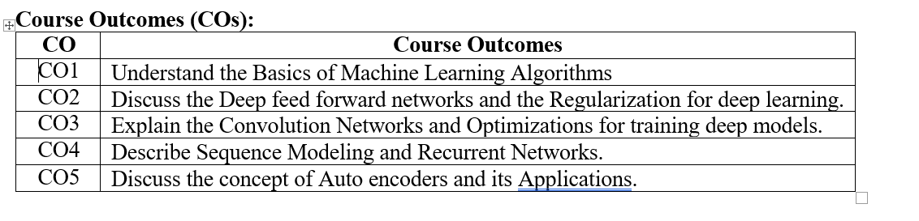
Course Outcomes
After completing this course, students should be able to:

Slide 4
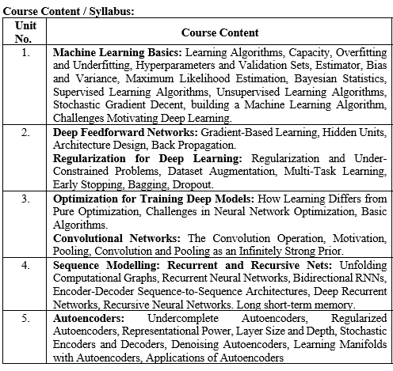
Syllabus

Slide 5
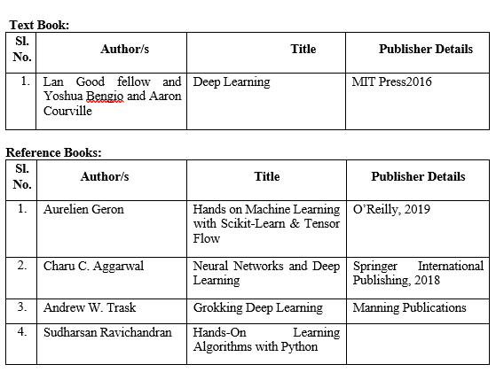
Text Books/ Reference Books

Slide 6
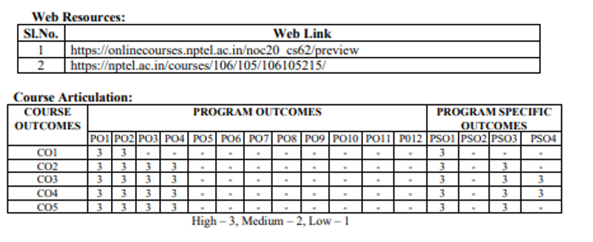
Web Resources and Course Articulation Matrix

Slide 7
Internal Assessment Weightage in Marks
Class Test –I 15
Quiz/Mini Projects/ Assignment/ seminars 10
Class Test – II 15
Total 40

Slide 8
SEE - Question Paper Pattern
Semester End Examination (SEE)
Semester End Examination (SEE) is a written examination of three hours duration of 100 marks with 60% weightage.
Note:
• The question paper consists of TWO parts PART- A and PART- B.
• PART- A consists of Question Number 1-5 are compulsory
(ONE question from each unit)
• PART-B consists of Question Number 6-15 will have internal choice.
(TWO question from each unit)
• Each Question carries 10 marks and may consist of sub-questions.
• Answer 10 full questions of 10 marks each

Slide 9
Acknowledgement:
Material is based on Text Book: Deep Learning by Ian Good fellow, Yashua Bengio and Aaron Courville
Multiple online resources including NPTEL video lectures, are used while preparing the Lecture Notes/ PPT.

Slide 10
UNIT – 1 Machine Learning Basics
1. Machine Learning Basics: Learning Algorithms, Capacity, Overfitting and Underfitting, Hyperparameters and Validation Sets, Estimator, Bias and Variance, Maximum Likelihood Estimation, Bayesian Statistics, Supervised Learning Algorithms, Unsupervised Learning Algorithms, Stochastic Gradient Descent, building a Machine Learning Algorithm, Challenges Motivating Deep Learning.

Slide 11
Quick look into AI/ML/DL/DS

Slide 12
Introduction/ Preamble
Artificial Intelligence (AI)
Machine Learning (ML)
Deep Learning (DL)
Data Science

Slide 13

Artificial Intelligence
It is a broad field of computer science that enables systems to mimic human behavior by analyzing vast amounts of data to recognize patterns and make predictions or generate new content.
Artificial intelligence (AI) is the capability of machines and computer systems to perform tasks that normally require human intelligence, such as learning, reasoning, decision-making, problem-solving, and understanding language.

Slide 14
Machine Learning
Machine learning (ML) is a branch or subset of Artificial Intelligence (AI) that enables computer systems to learn from data and improve their performance over time, without being explicitly programmed for each specific task.
By using algorithms to find patterns and correlations in data, ML models can make predictions, generate content, and automate complex decisions, becoming more accurate as they are exposed to more data.
It uses structured data
Uses statistical tools to explore the data

Slide 15
Variants of Machine Learning:
Supervised
Unsupervised
Reinforcement Learning

Slide 16
Deep Learning
It is the subset of ML, which mimic human brain.
It can use structured/unstructured data.
Three popular Deep Learning Techniques are:
ANN – Artificial Neural Network
CNN- Convolution Neural Network
RNN- Recurrent Neural Network

Slide 17
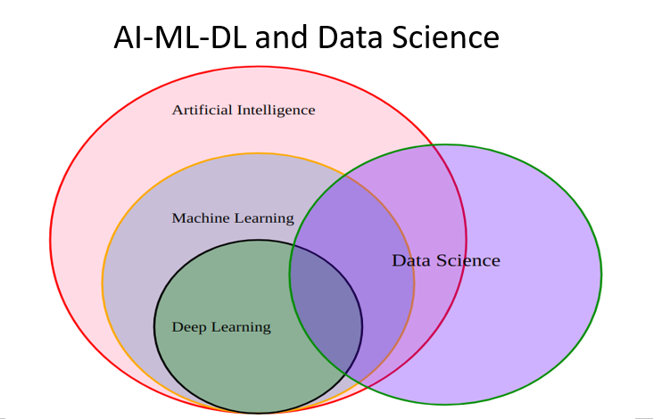
Summary:

Slide 18
Learning Algorithms

Slide 19
Learning Algorithm
It can be defined as :
“A computer program is said to
learn from Experience E
With respect to class of tasks T and
Performance measure P”.
Performance P increases as Experience increases

Slide 20
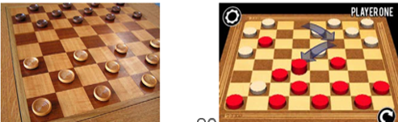
The First Learning Algorithm:
The Samuel’s Checker-Playing Program appears to be the world’s first self learning program.
Over thousands of games program started to learn to recognize the pattern, which patterns led to win or lose.

Slide 21
Learning algorithms : Example
E: The Experience of Playing thousands of games
T: Playing Checkers game
P: Fraction of games it wins against human opponents

Slide 22
Different Tasks
Many Kinds of tasks can be solved with ML. Some of the common machine learning tasks include the following:
Classification
Classification with Missing inputs
Regression
Transcription
Machine Translation
Structured Output
Anomaly Detection
Synthesis and Sampling
Imputation of missing values
Denoising
Density estimation

Slide 23
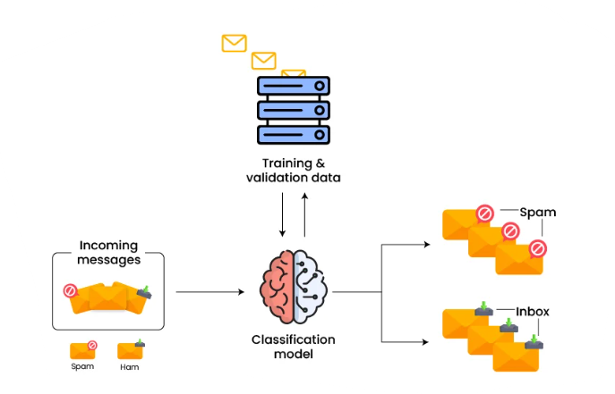
Classification
In this type of task, the computer program is asked to specify which of ‘k’ categories some input belongs to.
Example: Two class case: SPAM/INBOX

Slide 24
Classification with missing input
Classification is usually done with set of inputs.
When some of the inputs may be missing, rather than providing a single classification function, the learning algorithm must learn a set of functions.
Each function corresponds to classifying ‘x’ with a different subset of its inputs missing.
These kind of situation arises frequently in medical diagnosis, because many kinds of medical tests are expensive.

Slide 25
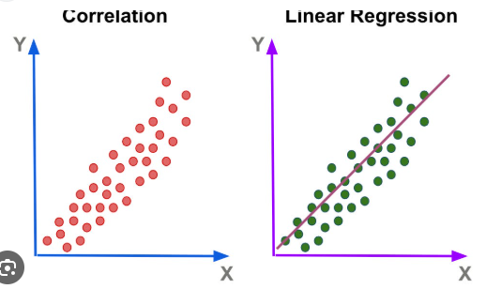
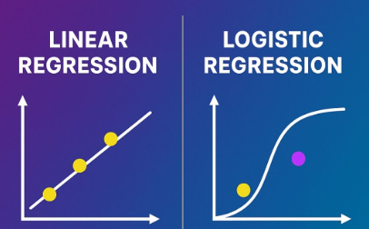
Regression
In this type of task the computer program is asked to predict a numerical value given some input.
Two variants of regression:
Linear Regression
Logistic Regression
Correlation between input and output will be converted into a linear regression model for future prediction.

Slide 26
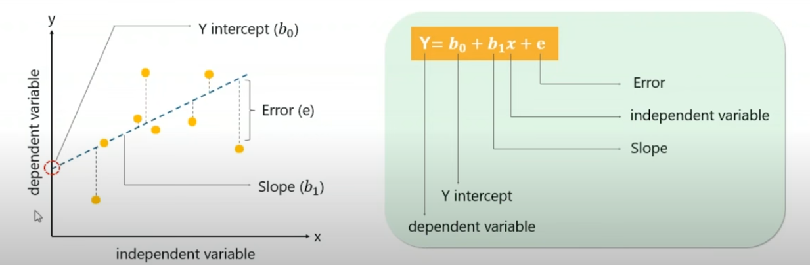
Linear Regression..continued

Slide 27
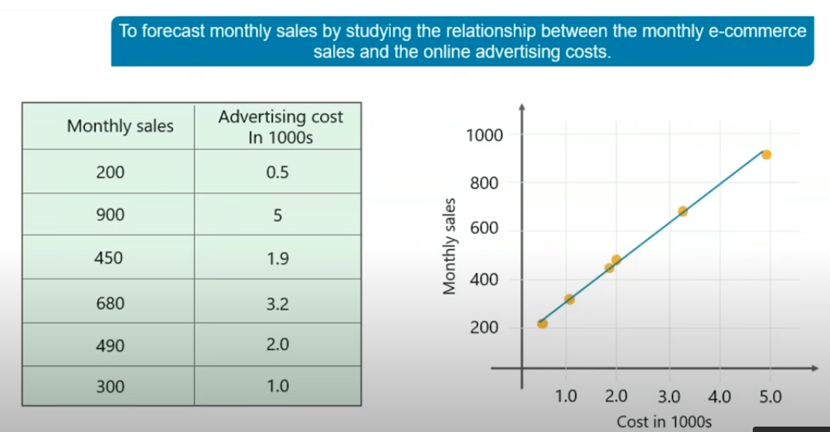
Example : Linear regression

Slide 28
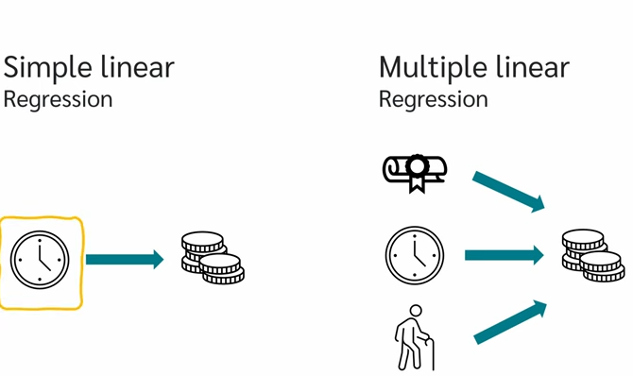
Simple vs. Multiple linear Regression
Simple: Single independent input variable is used to predict the output
Example: How many hours you work, will decide the salary component.
Multiple: Multiple independent input variables are used to predict the output.
Example: Salary is decided based on : Your qualification, Number of hours worked and also based on your experience.

Slide 29
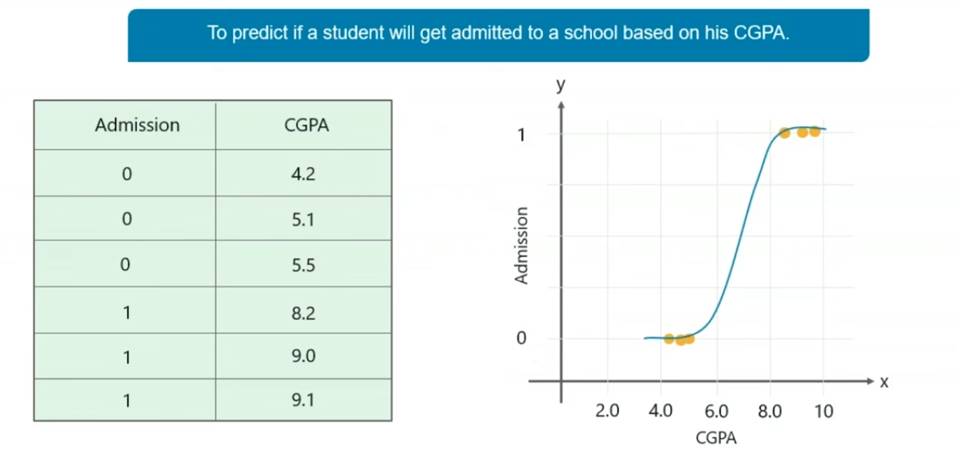
Example: Logistic Regression (0 or1)
Curved line is because the output will be anywhere between 0 and 1.
It will be set to 0 or 1 based on threshold.
Example indicates whether the students get admission or not.

Slide 30
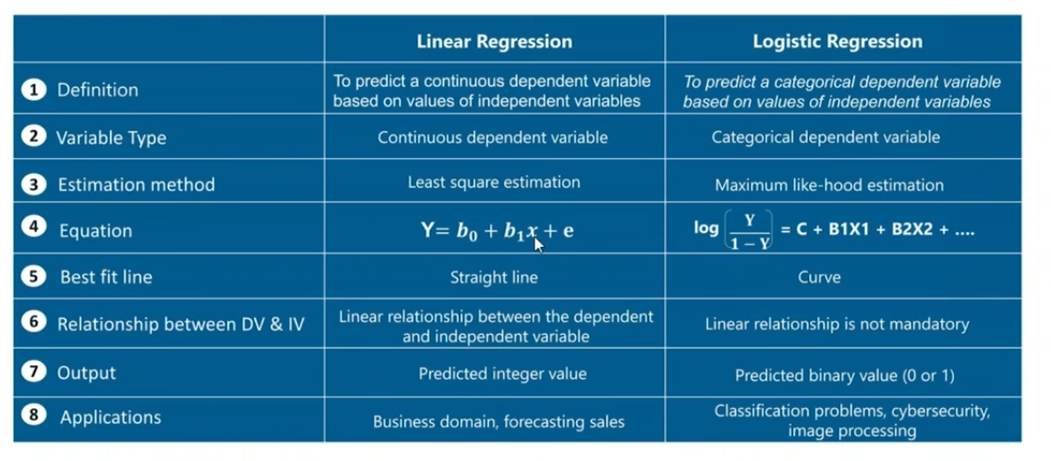
Linear Vs. Logistic Regression

Slide 31
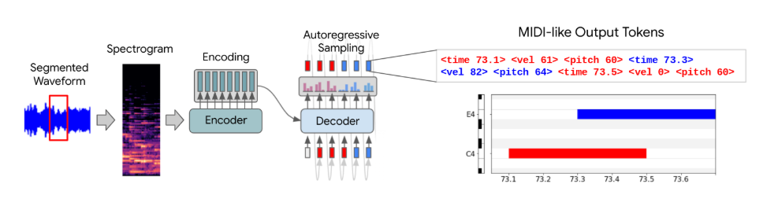
Transcription
In this type of task the machine learning system is asked to observe a relatively unstructured representation of some kind of data and transcribe the information into discrete textual form.
For example OCR : Text in the image format (unstructured) to editable text.
Another example Speech to Text. (Medical Transcription)

Slide 32
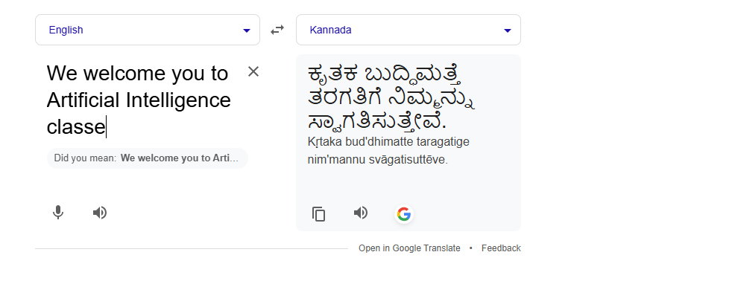
Machine Translation
In this input is already consists of sequence of symbols in some language and the computer program must convert this into a sequence of symbols in another language.

Slide 33
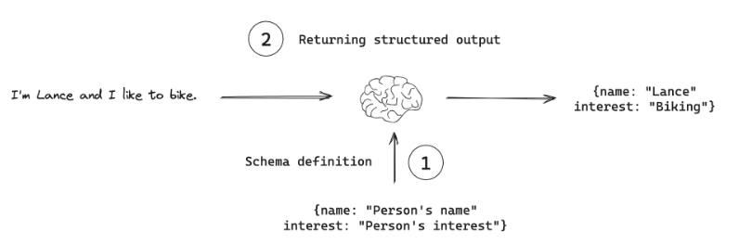
Structured Output
It involve any task where the output is a vector with important relationships between different elements.
This will be useful in applications like chatbot.

Slide 34
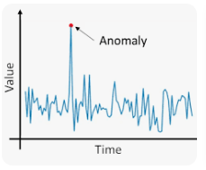
Anomaly detection
In this type of task computer program sifts through a set of events or objects and flags some of them as being unusual or atypical.
For example : credit card fraud detection.
By modeling your purchasing habits a credit card company can detect misuse of your cards.
Card can be placed on hold based on the uncharacteristic purchase.

Slide 35
Synthesis and Sampling
In this type of task, the machine learning algorithm is asked to generate new examples that are similar to those in the training data.
sampling involves selecting representative subsets of data from a larger dataset to train models efficiently.
Sampling is used when dealing with massive datasets where full analysis is impractical
Different methods of sampling: Random, Systematic & clustering
While synthesis (or data synthesis) involves creating entirely new, artificial data points to augment limited or sensitive real datasets.
Data synthesis addresses data scarcity, enhances data privacy by creating data independent of real records, and aids in domain adaptation, testing, and simulation

Slide 36
Imputation of missing values
Imputation in machine learning is the process of replacing missing data points in a dataset with substituted, estimated values to maintain the dataset's integrity and improve model accuracy.
This technique is crucial because most machine learning algorithms cannot process incomplete data.
Methods range from simple statistical averages (mean, median, mode) to more complex approaches like k-Nearest Neighbors (KNN) or regression models that consider relationships between variables.

Slide 37
Denoising
Denoising in machine learning is the process of removing unwanted noise from data to reveal underlying patterns, a crucial task in fields like computer vision and speech processing.
Machine learning models, especially deep learning techniques such as Convolutional Neural Networks (CNNs) and autoencoders, are highly effective at denoising by learning to distinguish signal from noise, achieving state-of-the-art results

Slide 38
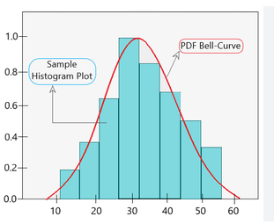
Density Estimation
Density estimation in machine learning is an unsupervised technique to infer the probability density function (PDF) of a dataset, essentially creating a probabilistic model that describes the underlying data distribution.

Slide 39
Capacity: Overfitting and Underfitting
Overfitting occurs when a model learns the training data too well, including noise, resulting in poor performance on new, unseen data(Testing).
Underfitting occurs when a model is too simple to capture the underlying patterns in the data, leading to poor performance on both training and new data (Testing).
The goal is to achieve a balance, where the model generalizes well to unseen data.

Slide 40
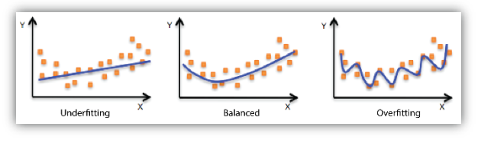
Graphical illustration: Underfitting/ Balanced and Overfitting

Slide 41
Hyperparameters and Validation Sets
In machine learning, a hyperparameter is an external configuration variable that is set by the data scientist before the training process begins to control the model's learning process.
Unlike internal model parameters (like weights and biases) which are learned from data, hyperparameters are manually specified to define the model's architecture, complexity, and how it learns, with examples including the learning rate, number of layers, and batch size.

Slide 42
Key Characteristics of Hyperparameters
External to the model:
They are not learned from the training data but are set by the user.
Control the training process:
Hyperparameters guide how the model learns and adjusts its internal parameters.
Influence model performance
Choosing the right hyperparameters is crucial for achieving optimal model performance
Manually set or tuned
Data scientists often use processes like hyperparameter tuning to find the best combination of values

Slide 43
Examples of Hyperparameters
Learning Rate: The step size used to update model parameters during training.
Batch Size: The number of training examples processed in one iteration before updating model parameters.
Number of Epochs: The number of times the entire training dataset is passed through the learning algorithm.
Number of Layers/Nodes (in Neural Networks): These define the model's architecture.
Regularization Parameters: Used to prevent overfitting by controlling model complexity.

Slide 44
Validation Sets
The validation set is a portion of your training data used to evaluate the performance for the model with a specific set of hyperparameters.
This is process is called hyperparameter tuning and helps to prevent your model from overfitting

Slide 45
Training/Validation/Testing
The process works as follows:
Split the data into 3 parts
Training Set : Used to train the model
Validation Set : Used to evaluate the model and tune the hyperparameters.
Test Set: Final evaluation of the performance of the model.

Slide 46
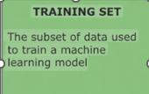
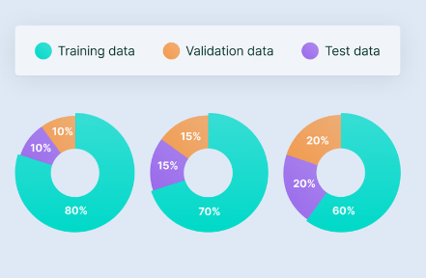
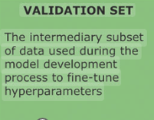
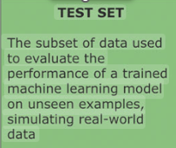
How to Split the data? ..Recommended Split

Slide 47
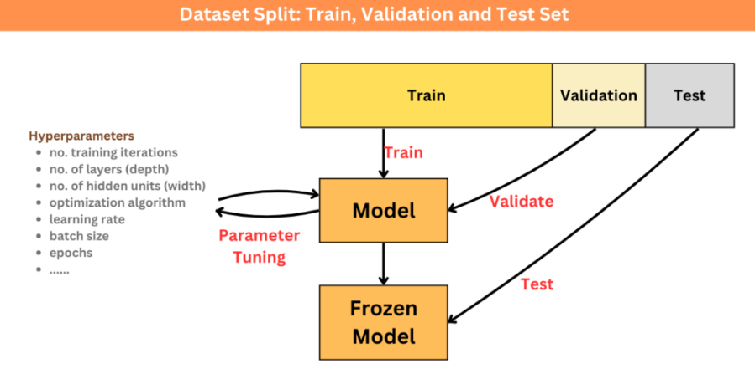
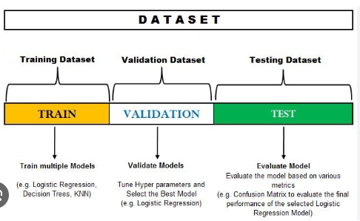
Train-Validate-Test

Slide 48
Cross Validation
A more robust method of evaluating models and tuning hyperparameters is K-Fold cross validation.
In this method, the training data is divided into ‘K’ equally sized “folds”.
The model is trained ‘k’ separate times. In each iteration, one fold is used as the validation set and remaining ‘k-1’ folds are used as the training set.
The performance scores from each iteration are averaged to give more reliable estimate of the model’s performance.
This approach ensures that every data point gets used for both training and validation.
This is popularly used for Hyperparameter tuning.

Slide 49
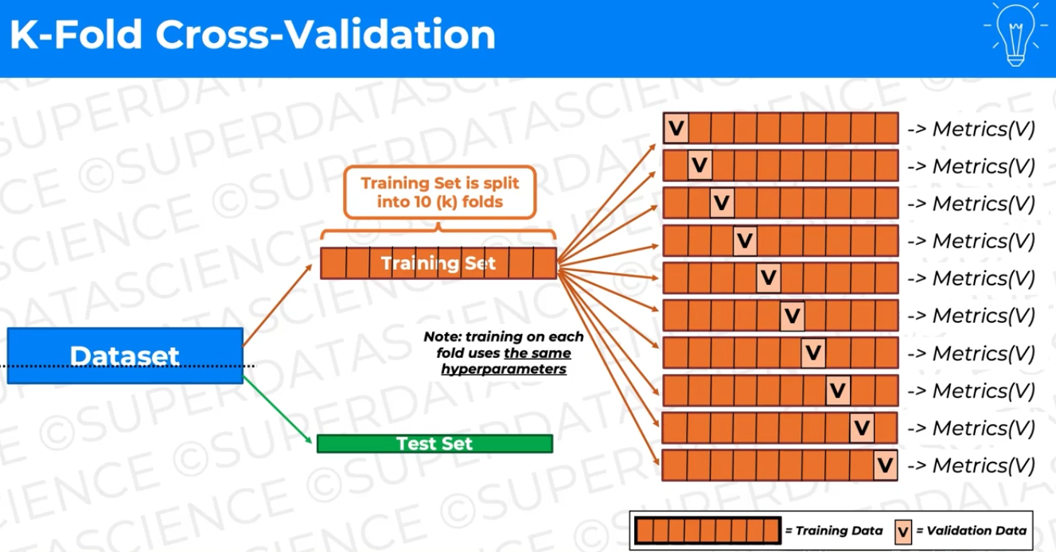
K-Fold Cross Validation: Example

Slide 50
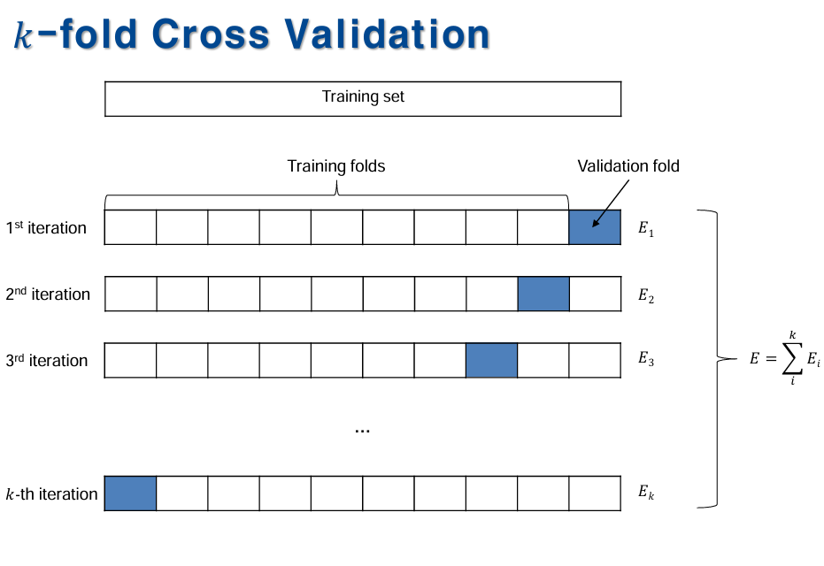

Slide 51
Estimator, Bias and Variance
Estimator:
In machine learning, an estimator is an equation for picking the “best,” or most likely accurate, data model based upon observations in realty.

Slide 52
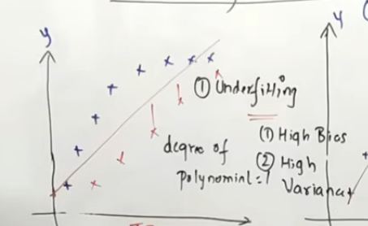
Bias.
Bias: It is the error during the training process.
If the model is estimated, which does not cover all the training sets, known as “underfitting”.
For example if the model is “Underfitting” , it is considered as “High Bias”.
Indicates errors during training phase.

Slide 53
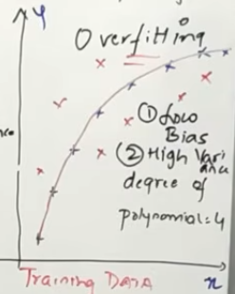
Variance
Variance is the error during the testing process.
If the model is estimated by fitting all the training data, then it is considered as “Over Fitting”
Overfitting works well during training but fails during testing.
Hence it is considered as Low Bias and High Variance.

Slide 54
Maximum Likelihood Estimation
Maximum Likelihood Estimation (MLE) in machine learning is a technique for finding the parameter values of a statistical model that maximize the probability (likelihood) of observing the given data.
It involves choosing a probability distribution, defining a likelihood function, and then finding the parameters that make the observed data most probable under that model.

Slide 55
Bayesian Statistics
Bayesian statistics mostly involves conditional probability, which is the probability of an event A given event B, and it can be calculated using the Bayes rule.
The concept of conditional probability is widely used in medical testing, in which false positives and false negatives may occur.
A false positive can be defined as a positive outcome on a medical test when the patient does not actually have the disease they are being tested for. In other words, it’s the probability of testing positive given no disease.
Similarly, a false negative can be defined as a negative outcome on a medical test when the patient does have the disease. In other words, testing negative given disease. Both indicators are critical for any medical decisions.

Slide 56
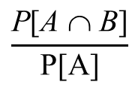
Bayes Theorem
Revisiting conditional probability
Suppose that we are interested in computing the probability of event A and we have been told event B has occurred.
Then the conditional probability of A given B is defined to be:
$$\frac{\text{P}\text{[}\text{A} \text{∩} \text{B}\text{]}}{\text{P}\text{[}\text{A}\text{]}}$$
Similarly, P[B|A] = if P[A] is not equal to 0

Slide 57
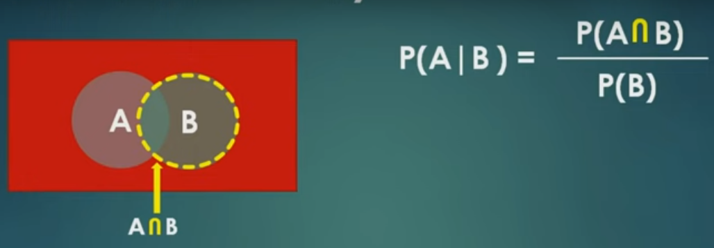
Original Sample space is the red coloured rectangular box.
What is the probability of A occurring given sample space as B.
Hence P(B) is in the denominator.
And area in question is the intersection of A and B

Slide 58
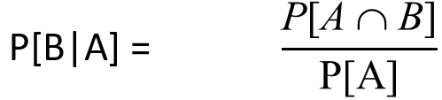
and
From the above expressions, we can rewrite
P[A ∩ B] = P[B].P[A|B]
and P[A ∩ B] = P[A].P[B|A]
This can also be used to calculate P[A ∩ B]
So
P[A ∩ B] = P[B].P[A|B] = P[A].P[B|A]
or
P[B].P[A|B] = P[A].P[B|A]
P[A|B] = P[A].P[B|A] / P[B] - Bayes Rule

Slide 59
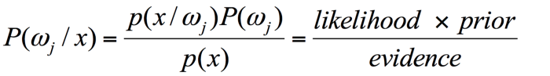
Bayes Theorem

Slide 60
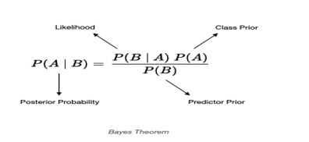
Example1:
Compute : Probability in the deck of cards (52 excluding jokers)
Probability of (King/Face)
It is given by P(King/Face) = P(Face/King) * P(King)/ P(Face)
= 1 * (4/52) / (12/52)
= 1/3

Slide 61
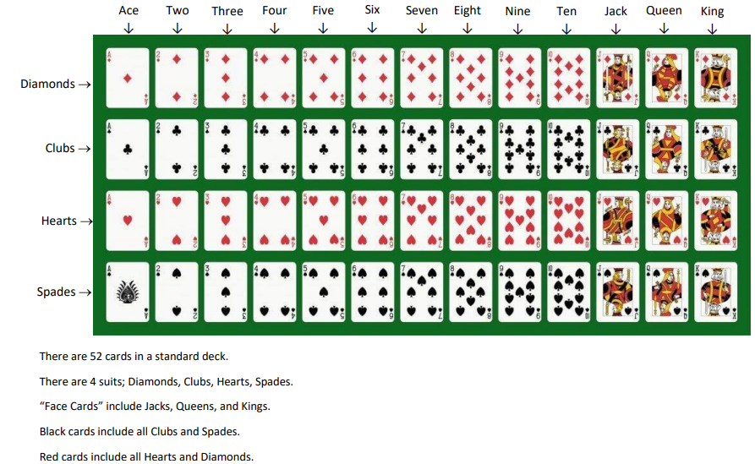

Slide 62
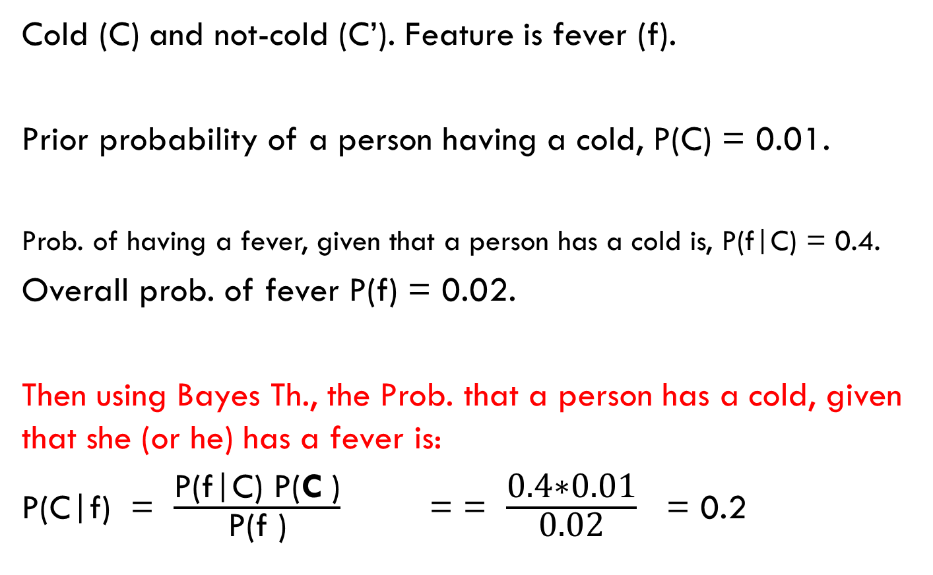
Example 2:
Cold (C) and not-cold (C’). Feature is fever (f).
Prior probability of a person having a cold, P(C) = 0.01.
Prob. of having a fever, given that a person has a cold is, P(f|C) = 0.4.
Overall prob. of fever P(f) = 0.02.
Then using Bayes Th., the Prob. that a person has a cold, given that she (or he) has a fever is:
P(C|f) = $\frac{\text{P}\text{(}\text{f}\text{|}\text{C}\text{) }\text{P}\text{(}\text{C} \text{)}}{\text{P}\text{(}\text{f}\text{ )}}$ = = $\frac{\text{0.4∗0.01}}{\text{0.02}}$ = 0.2

Slide 63
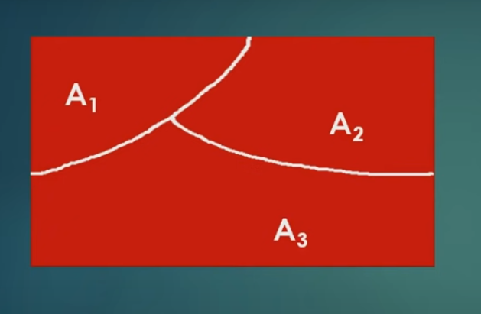
Generalized Bayes Theorem
Consider we have 3 classes A1, A2 and A3.
Area under Red box is the sample space
Consider they are mutually exclusive and
collectively exhaustive.
Mutually exclusive means, if one event occurs then
another event cannot happen.
Collectively exhaustive means, if we combine all the probabilities, i.e P(A1), P(A2) and P(A3), it gives the sample space, i.e the total rectangular red colored space.

Slide 64
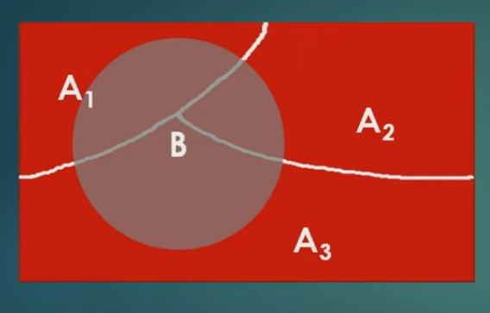
Consider now another event B occurs over A1,A2 and A3.
Some area of B is common with A1, and A2 and A3.
It is as shown in the figure below:

Slide 65
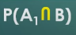
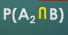
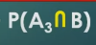
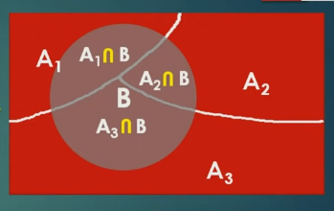
Portion common with A1 and B is shown by:
Portion common with A2 and B is given by :
Portion common with A3 and B is given by:
Probability of B in total can be given by

Slide 66
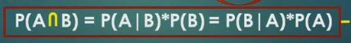
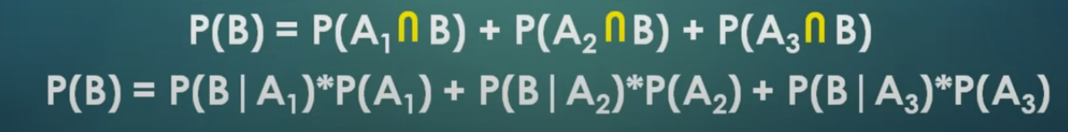
Remember :
Equation from the previous slide:
Replacing first in the second equation in this slide, we will get:

Slide 67
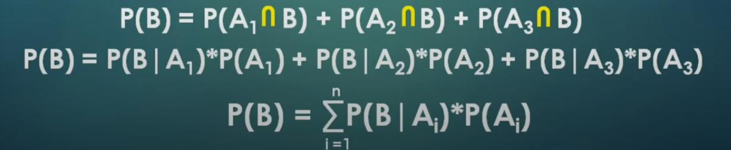
Further simplified P(B)

Slide 68
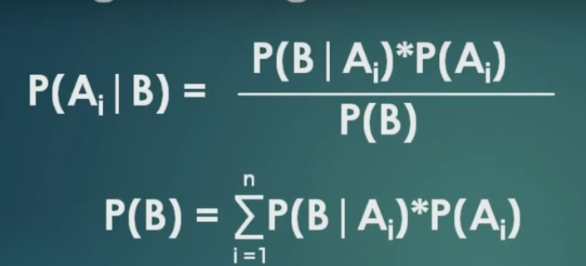
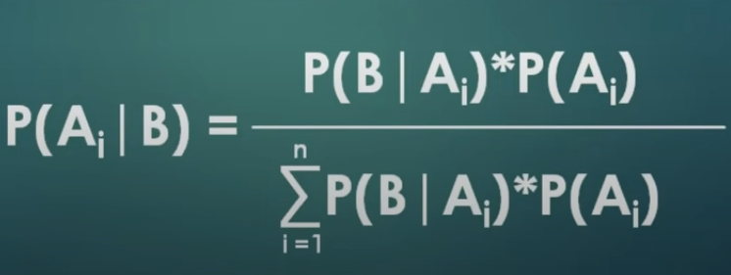
Arriving at Generalized version of Bayes theorem

Slide 69
Supervised Learning Algorithm
A supervised learning algorithm is a type of machine learning algorithm that learns from labeled training data to make predictions or classifications on new, unseen data.
In this paradigm, the algorithm is provided with input data and the corresponding desired output (labels), acting as a "supervisor" to guide its learning process.

Slide 70
Categories of Supervised Learning Algorithms
Supervised learning algorithms are broadly categorized into two main types:
Classification: Used when the output variable is categorical, meaning it falls into distinct classes or categories.
Examples include predicting whether an email is spam or not spam, or classifying images as containing a cat or a dog.
Common classification algorithms include Decision Trees, Support Vector Machines (SVMs), Logistic Regression, and K-Nearest Neighbors (KNN).
Regression: Used when the output variable is continuous, meaning it can take on any value within a given range.
Examples include predicting house prices, stock market trends, or a person's weight based on other features.
Common regression algorithms include Linear Regression, Polynomial Regression, and Regression Trees.

Slide 71
Examples of Supervised Learning Algorithm
Linear Regression: Predicts a continuous output based on a linear relationship with input features.
Logistic Regression: Used for binary classification tasks, predicting the probability of an input belonging to a specific class.
Decision Trees: Creates a tree-like model of decisions and their possible consequences, used for both classification and regression.
Support Vector Machines (SVMs): Finds an optimal hyperplane to separate data points into different classes.
Random Forest: An ensemble method that combines multiple decision trees to improve accuracy and reduce overfitting.
Convolutional Neural Networks (CNNs): Particularly effective for image and video analysis, used in tasks like image classification and object detection.

Slide 72
Linear and Logistic regression
Linear and logistic regression : Discussed earlier
Refer slides 25 – 30

Slide 73
Decision Tree
A decision tree in machine learning is a non-parametric supervised learning algorithm used for both classification and regression tasks.
It operates by recursively partitioning the dataset into subsets based on the values of input features, creating a hierarchical, tree-like structure.

Slide 74
Types of Decision Trees
Classification Trees: Used for classification problems, where the goal is to predict a categorical outcome (e.g., "yes" or "no," "spam" or "not spam").
Regression Trees: Used for regression problems, where the goal is to predict a continuous numerical value (e.g., house price, temperature).

Slide 75
Classification – Decision Tree
Decision tree builds classification or regression models in the form of a tree structure.
It breaks down a dataset into smaller and smaller subsets while at the same time an associated decision tree is incrementally developed.
The final result is a tree with decision nodes and leaf nodes. A decision node (e.g., Outlook) has two or more branches (e.g., Sunny, Overcast and Rainy).
Leaf node (e.g., Play) represents a classification or decision. The topmost decision node in a tree which corresponds to the best predictor called root node.
Decision trees can handle both categorical and numerical data.

Slide 76
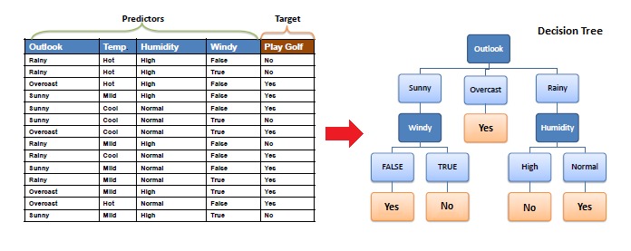
Example : Classification Decision Tree

Slide 77
Support Vector Machine (SVM)
A Support Vector Machine (SVM) is a supervised machine learning algorithm used for both classification and regression tasks.
It works by finding the optimal hyperplane that best separates data into different classes, aiming to maximize the margin between these classes for better generalization to new data.
SVMs are particularly useful for binary classification problems, such as spam detection, and can be adapted to handle non-linearly separable data through the use of kernel functions.

Slide 78
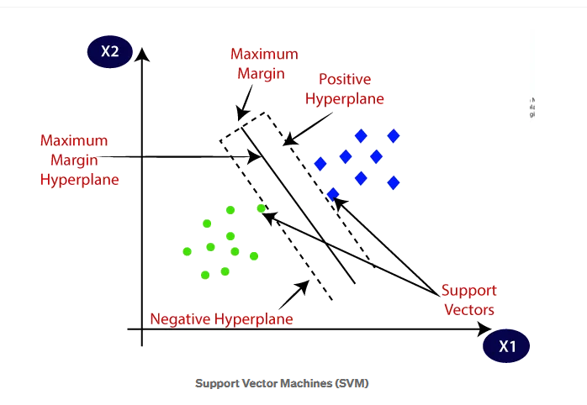
Support Vector Machines : Example

Slide 79
Random Forest
Random Forest is a supervised machine learning algorithm that leverages an ensemble of decision trees to make predictions.
It is used for both classification and regression tasks.
The core idea is to combine the predictions of multiple individual decision trees to achieve a more robust and accurate overall prediction, while also reducing the risk of overfitting.

Slide 80

Random Forest : Example

Slide 81
Un-supervised Learning Algorithms
Unsupervised learning algorithms are a category of machine learning algorithms that work with unlabeled data to discover hidden patterns, structures, and relationships within the dataset without any prior knowledge of the outcomes.
They are distinct from supervised learning, which requires labeled data for training.

Slide 82


Types of Unsupervised Learning Algorithms
Clustering
K-Means Clustering
Hierarchical Clustering
DBSCAN
Mean Shift Clustering
Gaussian Mixture Model (GMM)
Dimensionality Reduction
Principal component Analysis (PCA)
Singular Value Decomposition (SVD)
Autoencoders

Slide 83
What is Clustering?
Clustering is the task of dividing the population or data points into a number of groups such that data points in the same groups are more similar to other data points in the same group than those in other groups.
In simple words, the aim is to segregate groups with similar traits and assign them into clusters.
A good clustering will have high intra-class similarity and low inter-class similarity

Slide 84
Applications of Clustering
Recommendation engines
Market segmentation
Social network analysis
Search result grouping
Medical imaging
Image segmentation
Anomaly detection

Slide 85
The K-Means Algorithm
Input for this algorithm is K (the number of clusters) and ‘n’ samples, x1,x2,…xn.
Identify the centroids c1 to ck from the random locations. That is randomly select ‘k’ samples as centroids. (note: n should be greater than k)
For each remaining (n-k) samples, find the centroid nearest it. Put the sample in the cluster identified with this nearest centroid. After each sample is assigned, re-compute the centroid of the altered cluster.
Go through the data a second time. For each sample, find the centroid nearest it. Put the sample in the cluster identified with the nearest cluster. (During this step do not recompute the centroid)

Slide 86

Example:
Apply k-means Algorithm on the following sample points
Begin with two clusters {(8,4)} and {(24,4)} with the centroids
(8,4) and (24,4)
For each remaining samples,
find the nearest centroid and put it in that cluster.
Then re-compute the centroid of the cluster.
The next sample (15,8) is closer to (8,4) so it joins the cluster {(8,4)}.
The centroid of the first cluster is updated to (11.5,6).
(8+15)/2 = 11.5 and (4+8)/2 = 6.
The next sample is (4,4) is nearest to the centroid (11.5,6) so it joins the
cluster {(8,4),(15,8),(4,4)}.
Now the new centroid of the cluster is (9,5.3)
The next sample (24,12) is closer to centroid (24,4) and joins the cluster {(24,4),(24,12)}.
Now the new centroid of the second cluster is updated to (24,8).
At this point step1 is completed.

Slide 87
For step2 examine the samples one by one and put each sample in the identified with the nearest cluster centroid.
Sample | Distance to centroid (9,5.3) | Distance to centroid (24,8)
(8,4) | 1.6 | 16.5
(24,4) | 15.1 | 4.0
(15,8) | 6.6 | 9.0
(4,4) | 6.6 | 40.0
(24,12) | 16.4 | 4.0
Example: Sqrt ( square of (9-8) + square of (4-5.3) = 1.6

Slide 88
Final clusters of K-Means algorithms
So the new clusters are :
C1 = { (8,4), (15,8), (4,4) }
C2 = { (24,4), (24,12) }
K-Means algorithms ends.

Slide 89

Graphical Illustration : K-Means Clustering

Slide 90



Slide 91
Dimensionality Reduction

Slide 92
What is Dimensionality Reduction?
The number of input features, variables, or columns present in a given dataset is known as dimensionality, and the process to reduce these features is called dimensionality reduction.
A dataset contains a huge number of input features in various cases, which makes the predictive modeling task more complicated, for such cases, dimensionality reduction techniques are required to use.

Slide 93
Dimensionality Reduction…?
Dimensionality reduction technique can be defined as, "It is a way of converting the higher dimensions dataset into lesser dimensions dataset ensuring that it provides similar information."
These techniques are widely used in Machine Learning for obtaining a better fit predictive model while solving the classification and regression problems.
Handling the high-dimensional data is very difficult in practice, commonly known as the curse of dimensionality.

Slide 94
Benefits of Dimensionality Reduction..
By reducing the dimensions of the features, the space required to store the dataset also gets reduced.
Less Computation training time is required for reduced dimensions of features.
Reduced dimensions of features of the dataset help in visualizing the data quickly.
It removes the redundant features (if present).

Slide 95
Two ways of Dimensionality Reduction
1. Feature Selection
2. Feature Extraction

Slide 96
Feature Selection
Feature selection is the process of selecting the subset of the relevant features and leaving out the irrelevant features present in a dataset to build a model of high accuracy. In other words, it is a way of selecting the optimal features from the input dataset.

Slide 97

General – features reduction technique
In this example number 2 has 64 features… but many of them are of no importance to decide the characteristics of 2, are removed first.

Slide 98

Remove features which are of no importance

Slide 99
Feature Extraction
Feature extraction is the process of transforming the space containing many dimensions into space with fewer dimensions.
This approach is useful when we want to keep the whole information but use fewer resources while processing the information.

Slide 100

Example to show requirement of Dimensionality reduction
In this example important features to decide the price are town, area and plot size. Features like number of bathroom and trees nearby may not be significant, hence can be dropped.

Slide 101
PCA
PCA is a method of Dimensionality Reduction.
PCA is a process of identifying Principal Components of the samples.
It tries to address the problem of overfitting.

Slide 102

Example for PCA (from SK learn (SciKit Learn) library)

Slide 103

What does PCA do?
To address overfitting, reduce the dimension, without loosing the information.
In this example two dimension is reduced to single dimension.
But in general, their can be multiple dimensions… and will be reduced.
When the two dimension data (from the scatter plot shown) is viewed from one angle, it will be reduced to single dimension and the same is shown at the bottom right corner, and this will be Principal Component 1.

Slide 104


Similarly compute PC2
Figure shows the representation of PC1 and PC2.
Like this we have several principal components…
Say PC1,PC2, PC3… and so on..
In that PC1 will be selected as it has very less overlapping.
Each Principal Components are independent and are orthogonal. It means one PC does not depends on another…all of them are independent.

Slide 105

Example to illustrate the PC

Slide 106







Multiple angles in which picture can be captured

Slide 107
In previous slide, the last picture gives the right angle to take the picture.
It means, you have to identify a better angle to collect the data without loosing much information.
The angle shown in the last picture will capture all the faces, without much overlapping and without loosing information.

Slide 108




Slide 109
Gradient Descent (GD)
This is a method for parameter update.
In Gradient Descent, loss will be collected for all the training samples and weights will be updated by taking average of all the loss.
Say if we have 10,000 samples to be trained, then we will not be having 10,000 iterations. Will be collecting the loss of all the 10,000 samples. This completes one epoch and at the end of one epoch weights will be updated.
This method is also called Batch- GD

Slide 110

Stochastic Gradient Descent
The problem in Gradient Descent is, if the training data is too huge like 10 Lakhs or 50 Lakhs.. Then we need have huge RAM space to load all the samples and space is also required to hold the loss value for all the samples. As a solution researchers found another method called stochastic Gradient Descent.
Unlike traditional gradient descent, which uses the entire dataset for each update, SGD updates the model's parameters using a single, randomly selected training sample.

Slide 111
Min-Batch GD
Mini-batch gradient descent is a popular optimization algorithm that updates model parameters using small subsets of the training data, called mini-batches.
It balances the stability of batch gradient descent (using the whole dataset) with the efficiency of stochastic gradient descent (using one data point at a time). This approach leads to faster convergence and computational efficiency, especially for large datasets, while also introducing a bit of randomness that can help

Slide 112

GD/SGD/Mini-Batch

Slide 113

Building a machine learning algorithm
Most deep learning algorithms follow a common structure:
• Dataset – input samples for training
• Model – defines data relationships
• Cost Function – measures prediction error
• Optimization Method – updates model parameters

Slide 114
Challenges : Motivating Deep Learning
Challenges that motivated the development of deep learning include :
the limitations of traditional methods in handling complex,
high-dimensional data, which led to poor generalization and scalability.
Other key motivators were the need for automatic feature learning to overcome the burden of manual feature engineering, and the desire for models that could solve complex AI problems like speech recognition.
The shift also aimed to improve performance on large datasets, enabled by advances in hardware like GPUs and TPUs.

Slide 115
End of Unit - 1

